Slide 1

Windows Server 2008 R2:
Besser fürs Unternehmen
Nils Kaczenski
WITcom, Lingen, 11. Juni 2009

Slide 2


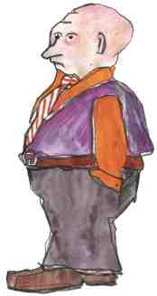

Ein ganz normaler Tag in der IT
?
WAN ist zu langsam!
AD ist zu kompliziert!
Hallmackenreuther GmbH
Zu viele Computer!
Windows? Klickibunti. (Hihi)
Marc Hallmackenreuther
Karl Koop
Thomas Broccoli
Ellen Bogen
Notes:
Frau Bogen hat ein Problem.
IT-Leiterin des mittelständischen Unternehmens Hallmackenreuther GmbH
Typisches „gewachsenes“ Netzwerk mit einer Reihe von Servern und einer beachtlichen Anzahl von Diensten und Applikationen
Natürlich auch eine bunte Mischung von PC-Arbeitsplätzen
Sie hat ein weiteres Problem: Seit einigen Wochen hat sie einen neuen Geschäftsführer, und zwar den Sohn des Firmengründers
… der hat ein neues Lieblingsthema: Verfügbarkeit
und nun?

Slide 3



Wer vor Ihnen steht
Nils Kaczenski
Leiter Consulting & Support
WITcom Hannover
  Windows, Exchange, SQL
  Verfügbarkeit, Sicherheit
  Strategische Beratung
  Projektleitung
Fachautor Windows
  Microsoft Press
  iX, cʼt, IT-Administrator
Nils.Kaczenski@witcom-hannover.de

Slide 4













What Is The Springboard Series
Inside of Microsoft we are:
A turnkey IT pro engagement platform for depth & breadth
The program to mobilize MS marketing & field to focus on desktop OS IT pros
To the IT pro, our goal is:
Be the definitive resource for Desktop IT pros
  Open, honest; show don’t tell
  Information at right time, right level across Adoption Lifecycle
The Springboard Series IT pro experience offers dynamic content and structured guidance across the adoption lifecycle
Weekly, Monthly and Quarterly Rhythm of Topical Content
Virtual Roundtable Events
Monthly Feature Articles & Guides
Event Kits (Win 7 updates) and messaging
Weekly Targeted IT Pro Drive-time Podcasts
TechCenter in
10 languages
Notes:
The Springboard Series program was developed in response to primary research conducted with IT Pros worldwide (direct interviews, focus groups) and key MS field roles (TSPs, ATSs, ITEs, PAMs, TAMs, Architects). The findings fell into two areas—the need to make learning about how a new OS environment directly impacts the IT Pro more consumable (and the messages more relevant), and how the mis-handling of Vista to this audience has cost us in poor NSAT and perceptions
To remedy this situation, the Win Client IT pro audience developed a program to provide the right information, at the right technical level, at the right point in the adoption lifecycle, and to do so in a frank, open and honest tone. This program has two major components—a breadth effort that touches IT pros directly (through Technet and related properties), and a depth component that supports field and partner engagements

Slide 5
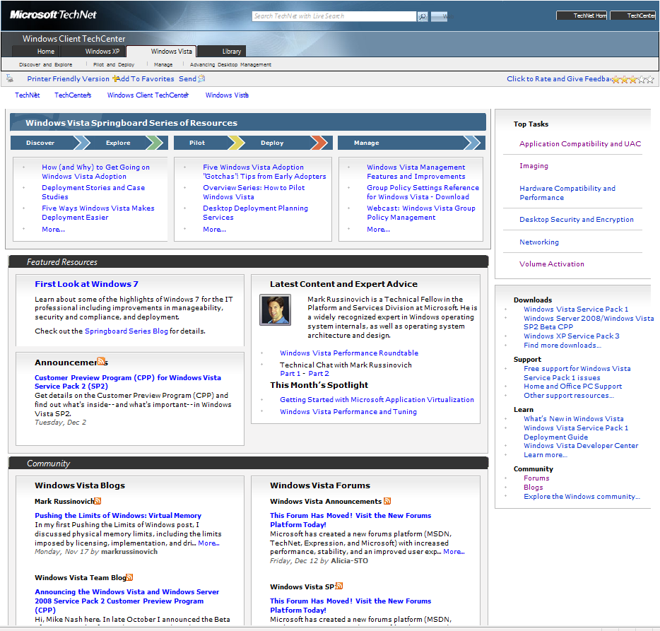
Springboard Series on TechNet: The Key Resource for IT Pros
Adoption lifecycle assets: right level, right time
“Zones” for top tasks
Weekly & Monthly dynamic content
Springboard Series Blog—dynamic updates
Top assets: downloads, learning
Community blogs, forums
www.microsoft.com/springboard (in 10 languages)

Slide 6
Was Sie erwartet
Alles neu macht R2
Brummt besser: Hyper-V 2.0
Zugriff erlaubt: Remote Desktop Services
Filiale mit Vorrat: BranchCache
Aktiver Papierkorb: Active Directory in R2
Fensterlos: Windows Server Core

Slide 7
Was Sie erwartet
Alles neu macht R2
Brummt besser: Hyper-V 2.0
Zugriff erlaubt: Remote Desktop Services
Filiale mit Vorrat: BranchCache
Aktiver Papierkorb: Active Directory in R2
Fensterlos: Windows Server Core

Slide 8

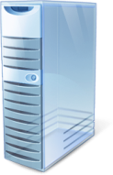
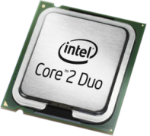
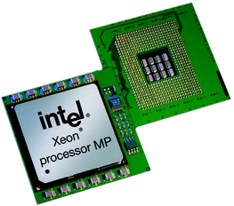

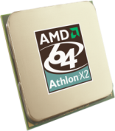


Windows Server R2: Mehr als ein Update
Unterstützung aktueller Hardware, Treiber und Applikationen
  Ziel: Kompatibilität zu Windows Server 2008
Fit für künftige Hardware-Entwicklungen
  Multicore
  >64 CPUs
  Virtualisierung
  Energiemanagement
Fundament für das nächste „Major Release“
  VHD Boot
  SaaS
Entwicklung wieder völlig parallel zum Client-Windows
Energie
Virtualisierung
Multi/Many-core
64-Bit

Slide 9

Wieviel Windows und wann?
Server-Editionen bleiben erhalten
  Standard Edition
  Enterprise Edition
  Datacenter Edition
  Web Server Edition
Vollinstallation oder Core
Nur x64!
RTM parallel zu Windows 7 erwartet (Sommer/Herbst 2009)
  RC frei verfügbar
Details zu Lizenzen noch nicht veröffenlicht
  Itanium Edition
  Daneben: Hyper-V Server 2008 R2
  Weitere Spezialversionen noch unklar

Slide 10
Was Sie erwartet
Alles neu macht R2
Brummt besser: Hyper-V 2.0
Zugriff erlaubt: Remote Desktop Services
Filiale mit Vorrat: BranchCache
Aktiver Papierkorb: Active Directory in R2
Fensterlos: Windows Server Core
Zu viele Computer!
Ellen Bogen

Slide 11
Hyper-V: Architektur
Provided by:
OS
ISV / IHV / OEM
Microsoft Hyper-V
Parent Partition
Child Partitions
Microsoft / XenSource
Applications
Applications
Applications
VM Worker Processes
Applications
User Mode
WMI Provider
VM Service
Windows Server 2008
Windows Server 2003, 2008
Non-Hypervisor Aware OS
Xen-Enabled Linux Kernel
Windows Kernel
VSP
Windows Kernel
Linux VSC
VSC
IHV Drivers
VMBus
Kernel Mode
VMBus
VMBus
Emulation
Hypercall Adapter
Windows hypervisor
Ring -1
“Designed for Windows” Server Hardware

Slide 12
Hyper-V: Alles neu in R2
Flexibler
  Live Migration
  Cluster Shared Volumes
  Hot Add/Remove für Storage
Mehr Performance
  Besseres Speichermanagement
    Second Level Address Translation (SLAT)
    Aber: kein Dynamic Memory
  Unterstützung für TCP Offload
  Virtual Machine Queue (VMQ) Support
  Jumbo Frames
Größere Skalierbarkeit
  32 logische CPUs pro VM
  Energiesparen durch Core Parking

Slide 13

Live Migration

Slide 14
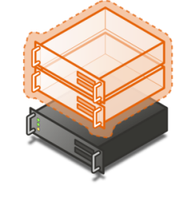


Quick Migration vs. Live Migration
Quick Migration
(Windows Server 2008 Hyper-V)
Save state
  Create VM on the target
  Write VM memory to shared storage
Move virtual machine
  Move storage connectivity from source host to target host via Ethernet
Restore state & Run
  Take VM memory from shared storage and restore on Target
  Run
Live Migration
(Windows Server 2008 R2 Server Hyper-V)
VM State/Memory Transfer
  Create VM on the target
  Move memory pages from the source to the target via Ethernet
Final state transfer and virtual machine restore
  Pause virtual machine
  Move storage connectivity from source host to target host via Ethernet
Un-pause & Run
Host 1
Host 2
Host 1
Host 2

Slide 15
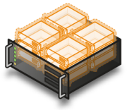




Live Migration: Gemeinsame Disk
Bisher (NT4 bis Hyper-V 1.0)
  „Shared Nothing“-Cluster
  Im Cluster: Pro VM eine LUN
Cluster Shared Volumes in Windows Server 2008 R2
  CSV: Ein einzelner Speicherbereich
  Alle Clusterknoten sehen dasselbe Storage
  Zunächst nur für Hyper-V
Vorteile
  Leicht einzurichten
  Ein gemeinsamer Datenpool
  Keine Grenze durch Laufwerksbuchstaben
  Leichte Migration/Update

Slide 16
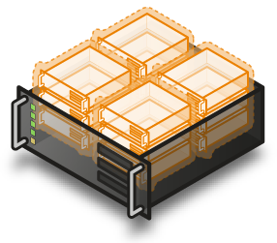
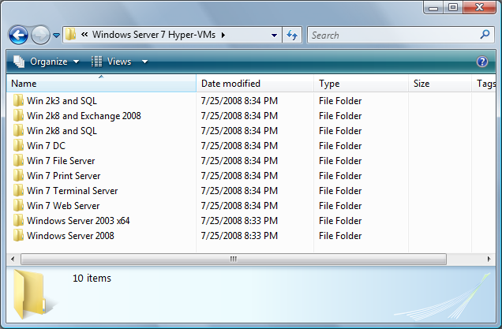

Cluster Shared Volumes
Alle Server sehen dasselbe Storage

Slide 17

Hot Add/Remove Storage
Hinzufügen und Entfernen von VM-Festplatten
  VHD
  Pass-through Disks
  Über virtuellen SCSI-Controller angebunden (kein IDE)
Vorteile
  Erweitern der Speicherkapazität ohne Downtime
  Erweiterte Backup-Szenarien
  Neue Szenarien für Datenbanken wie Exchange oder SQL

Slide 18
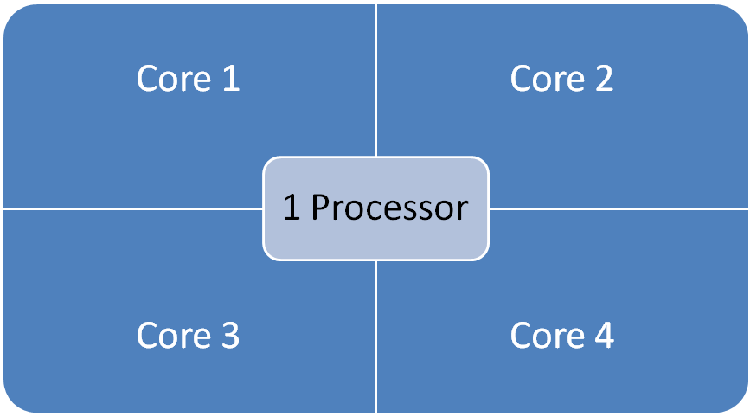

Windows Server 2008: 16 LP Server

Slide 19
Server Core Parking: 16 LP Server
Processor is “parked”
Processor is “parked”

Slide 20
Was Sie erwartet
Alles neu macht R2
Brummt besser: Hyper-V 2.0
Zugriff erlaubt: Remote Desktop Services
Filiale mit Vorrat: BranchCache
Aktiver Papierkorb: Active Directory in R2
Fensterlos: Windows Server Core

Slide 21


Raider heißt jetzt Twix
TS RemoteApp™ | RemoteApp™
TS Gateway | RD Gateway
TS Session Broker | RD Connection Broker
TS Web Access | Remote Desktop Web Access
TS Easy Print | RD Easy Print
Notes:
Terminal Services →Remote Desktop Services
Terminal Services RemoteApp™→RemoteApp™
Terminal Services CAL→ Remote Desktop Services CAL
Terminal Services Web Access → Remote Desktop Web Access
Terminal Services Gateway→ Remote Desktop Gateway
Terminal Services Session Broker→ Remote Desktop Connection Broker

Slide 22


WS 2008 R2 Neu & Besser
NEU!
Besser
Besser
TS & VDI: Integrierte Lösung
Hyper-V-Support für virtuelle Desktops
Einheitliche Infrastruktur
SCVMM-Support
Remote-Zugriff auf Applikationen
RemoteApp & Desktop Connections
Bessere RD Gateway Security
Hochwertige RemoteApp & Desktops
Echter Multi-Monitor-Support
Multimedia & Bidirektionales Audio
2D- und 3D-Remoting for DirectX 10.1
RemoteApp & Desktop Web Access
Neuerungen in Plattform & Management
Neues API, Erweiterbarer Connection Broker,
Powershell-Support, Best Practices Analyzer, Voller MSI-Support
Notes:
Extending Remote Desktop Services to provide tools to enable a Virtual Desktop Infrastructure (VDI). The in-box Remote Desktop Services capability is targeted at low-complexity deployments and as a platform for partner solutions, which can extend scalability and manageability to address the needs of more demanding enterprise deployments. Combined with Microsoft Hyper-V Server, System Center Virtual Machine Manager, App-V within MDOP, and VECD licensing, Microsoft provides a complete end to end VDI solution.
Providing simplified publishing and access to Remote Desktops and Applications. The New Remote Desktop & Application feed provides a set of resources, such as RemoteApp programs and Remote Desktops. These feeds are presented to Windows 7 users using the new RemoteApp & Desktop Connection control panel. The new RemoteApp & Desktop Web Access provides the ability to connect to resources from Vista & XP in addition to Windows We need to decide if we are willing to use this word.
Improving User Experience through new Remote Desktop Protocol capabilities. These new capabilities, enabled with Windows Server 2008 R2 in combination with Windows7 Enterprise Edition and Ultimate Edition, improve significantly the experience of remote users, making it more similar to the experience enjoyed by users accessing local computing resources.
We have a more complete remote application and desktop access solution.
The New Remote Desktop & Application connections provides a set of resources, such as RemoteApp programs and Remote Desktops. These connections are presented to Windows 7 users using the new RemoteApp & Desktop Connection control panel. The new RemoteApp & Desktop Web Access provides the ability to connect to resources from Vista & XP in addition to Windows 7.
RemoteApp & Desktop Web Access - provides integration with RemoteApp & Desktop Connections to ensure a consistent list of applications is available to the user at all time, irrespective of the desktop OS used. The default web page provides a fresh and inviting look and feel and includes a new web based login with integrated single sign-on.
Remote Desktop Gateway - RDG securely provides access to these resources from Internet without the need for opening additional ports or the use of a VPN. RDG provides this by tunneling RDP over HTTPS and incorporating may security conscious features; in addition to the features from previous releases we have added This stuff is pretty good, almost needs its own section, perhaps we should have a security section
Completing the Remote Desktop Services toolset addressing customer needs. Remote Desktops Services in Windows Server 2008 R2 focuses on improving management for all the existing scenarios delivered previously in Terminal Services and the exciting new scenarios in Remote Desktop Services; additionally we have added features to help improve application compatibility

Slide 23









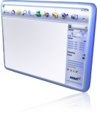








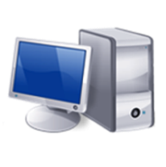




Hosted Virtual Desktops
TS-based
Remote Desktop
Hyper-V-based
Remote Desktop
Remote Desktop Connection Broker
Virtual Machine Management (SCVMM)
Notes:
Hyper-V support for VDI - Providing a better virtualization platform for scalable and highly available VDI deployments
Live Migration of Virtual Machines – With Live Migration, there will be no perceived downtime in the desktop workloads running in the VM, and network connections from and to the VM being migrated will stay connected. This capability will be possible between hosts within a High Availability cluster.
Support for Enhanced Virtualization Capabilities in the Hardware – Support for Nested Page Tables (NPT) and Extended Page tables (EPT) in Intel and AMD hardware. These capabilities improve the performance of translation of memory addresses.
The new Remote Desktop Connection Broker, which extends the Session Broker capabilities already found in Windows Server 2008, creates a unified admin experience for traditional session-based remote desktops and (new) virtual machine-based remote desktops. The two key deployment scenarios supported by the Remote Desktop Connection Broker, besides traditional TS, are persistent (permanent) VMs and pooled VMs. In either case, the in-box solution supports storage of the image(s) on the Hyper-V host.
SCVMM 2008 support provides intelligent placement of VMs during placement, fast and reliable P2V and V2V (VMware to Hyper-V) conversions as well monitoring of all virtual and physical assets from “one single pane of glass”.

Slide 24





VDI mit Windows Server 2008 R2
Microsoft® App –V
Centralized Desktop
Partner Solutions

Slide 25
Was Sie erwartet
WAN ist zu langsam!
Alles neu macht R2
Brummt besser: Hyper-V 2.0
Zugriff erlaubt: Remote Desktop Services
Filiale mit Vorrat: BranchCache
Aktiver Papierkorb: Active Directory in R2
Fensterlos: Windows Server Core
Marc Hallmackenreuther

Slide 26










Arbeiten in der Filiale
Zugriff heute
Was Windows 7 ändert
BranchCache™

Slide 27






BranchCache: Zentral oder dezentral
Enterprise
Distributed Cache
Hosted Cache
Distributed Cache
Data cached in cache pool
Data cached at the host server

Slide 28

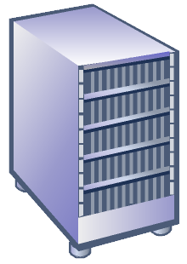




BranchCache Distributed Cache
Main Office
ID
Get
Data
ID
Data
Get
Get
Get
Data
Branch Office

Slide 29
BranchCache Hosted Cache
Main Office
Get
ID
Data
Data
ID
ID
Get
Get
Get
Search
Search
ID
Data
Advertize
ID
Request
Branch Office
ID
Data
Put

Slide 30






BranchCache einrichten
Gruppenrichtlinien: BranchCache auf Windows 7 aktivieren
Branch Office
Branch Office
Optionales Feature “Windows BranchCache” auf einem Windows 2008 R2 Web- oder Dateiserver
Hosted
Cache
Branch Office
IIS
File Server
  Optional: Hosted Cache in der Filiale einrichten und bei den Clients konfigurieren
Group Policy
Management
Main Office

Slide 31
BranchCache Management
Verwaltung per Gruppenrichtlinie oder netsh
  Distributed Cache ein-/ausschalten
  Hosted Cache ein-/ausschalten
  Größe des Cache
  Standort des Hosted Cache bekanntgeben
  Cache löschen
  Shared Key für Cluster-Systeme einrichten
  u. v. m. …

Slide 32

… anfassen!
demo
BranchCache: Management

Slide 33
Was Sie erwartet
AD ist zu kompliziert!
Alles neu macht R2
Brummt besser: Hyper-V 2.0
Zugriff erlaubt: Remote Desktop Services
Filiale mit Vorrat: BranchCache
Aktiver Papierkorb: Active Directory in R2
Fensterlos: Windows Server Core
Karl Koop

Slide 34
ADAC und der Papierkorb
AD Administration Center
AD-Papierkorb
AD BPA
Managed Service Accounts
Offline Domain Join

Slide 35
… anfassen!
demo
Active Directory in R2

Slide 36
Was Sie erwartet
Alles neu macht R2
Brummt besser: Hyper-V 2.0
Zugriff erlaubt: Remote Desktop Services
Filiale mit Vorrat: BranchCache
Aktiver Papierkorb: Active Directory in R2
Fensterlos: Windows Server Core
Windows? Klickibunti. (Hihi)
Thomas Broccoli

Slide 37
Windows ohne Windows
Windows Server Core
  Installationsvariante von Windows Server 2008 R2
  Kein Up- oder Downgrade
Schlanke Server-Variante
  Definierte Aufgaben
  Reduzierte Dienste und Funktionen
  Kein Explorer-GUI
  Verwaltung per Kommadozeile
  Verwaltung remote

Slide 38
… anfassen!
demo
Windows ohne Windows

Slide 39
Fragen
?
!
Alles neu macht R2
Brummt besser: Hyper-V 2.0
Zugriff erlaubt: Remote Desktop Services
Filiale mit Vorrat: BranchCache
Aktiver Papierkorb: Active Directory in R2
Fensterlos: Windows Server Core

Slide 40


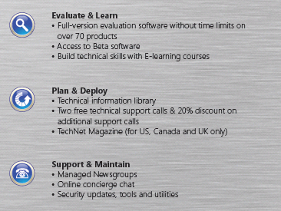

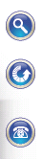

What is TechNet Plus?
TechNet Plus Subscriptions – a comprehensive tool kit for IT Pros to help evaluate, deploy, and support Microsoft products
Get Hands on Experience with the Latest Microsoft Technologies
EVALUATION
DEPLOYMENT
Plan for future Deployments
SUPPORT
Resolve Technical Issues Faster
Build Technical skill
Boost Productivity
Fully evaluate Microsoft Solutions

Slide 41
Win a TechNet Plus Subscription
To win a TechNet Plus Subscription, fill out an online survey here:
  http://tinyurl.com/STEP040/
Two surveys at each event will be picked at random to win a subscription good for one year.
TechNet Plus gets you:
  Windows 7 and Server 2008 R2 First!
  No time bombs!
  No fighting for product keys
  More time to evaluate
  More tools and resources

Slide 42
Mehr Fragen? Mehr Antworten!
Nils.Kaczenski@witcom-hannover.de
WITcom High-End-Workshops
Microsoft TechNet: Tech Day in Hannover am 16. Juni 2009
  Windows 7 & Windows Server 2008 R2
  Seminare, Chalk Talk, Networking
  http://www.event-team.com/events/techday/

